Slide 1
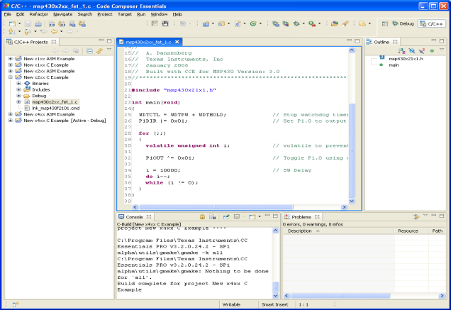
S06: Assembler / Linker
Required: PM: Ch 7, pgs 81-107 Assembler Directives
Recommended: MSP430 Assembly Tutorial MSP430 Disassembly.docx FUG: 3.4

Slide 2
CS 224
Chapter | Lab | Homework
S00: Introduction
Unit 1: Digital Logic
S01: Data Types S02: Digital Logic | L01: Warm-up L02: FSM | HW01 HW02
Unit 2: ISA
S03: ISA S04: Microarchitecture S05: Stacks / Interrupts S06: Assembly | L03: Blinky L04: Micro-arch L05b: Traffic Light L06a: Morse Code | HW03 HW04 HW05 HW06
Unit 3: C
S07: C Language S08: Pointers S09: Structs S10: I/O | L07b: Morse II L08a: Life L09b: Snake | HW07 HW08 HW09 HW10

Slide 3
Learning Outcomes…
After completing this section, you should be able to
Explain the difference between a low level and high level language.
Justify the study/use of assembly code.
Contrast assembler directives with assembler code.
Describe the assembly/linker process.
Contrast a library with a computer program.
Describe the different types of program sections and explain how they are used by the linker to create an executable.
Give examples of emulated and intrinsic instructions.
Use systematic decomposition to create an assembly program.

Slide 4
Topics to Cover…
High Level vs. Assembly
Assembly Instructions
Emulated Instructions
Assembler
Assembly Code
Assembly Sections
Assembly Process
Assembly Directives
Linker
Libraries
Linking multiple files
How to Code in Assembly
Systematic Decomposition

Slide 5
High Level vs. Assembly
High Level vs. Assembly
High Level Languages
More programmer friendly
More ISA independent
Each high-level statement translates to several instructions in the ISA of the computer
Assembly Languages
Lower level, closer to ISA
Very ISA-dependent
Each instruction specifies a single ISA instruction
Makes low level programming more user friendly
More efficient code

Slide 6
Why Assembly Code?
High Level vs. Assembly
Allows us to work at a slightly higher level than machine language.
Allows us to use symbolic names for opcodes
Allows us to use symbolic names for memory locations -
SUM, PRODUCT
Don’t need to know every address of every storage location.
Calculates addresses for us – really a big deal!
Helps to allocate memory locations.
Provides additional error checking

Slide 7
Assembly Instructions

Slide 8
Double Operand
Double Operand Instructions
Mnemonic | Operation | Description
Arithmetic instructions
ADD(.B or .W) src,dst | src+dst→dst | Add source to destination
ADDC(.B or .W) src,dst | src+dst+C→dst | Add source and carry to destination
DADD(.B or .W) src,dst | src+dst+C→dst (dec) | Decimal add source and carry to destination
SUB(.B or .W) src,dst | dst+.not.src+1→dst | Subtract source from destination
SUBC(.B or .W) src,dst | dst+.not.src+C→dst | Subtract source and carry from destination
Logical and register control instructions
AND(.B or .W) src,dst | src.and.dst→dst | AND source with destination
BIC(.B or .W) src,dst | .not.src.and.dst→dst | Clear bits in destination
BIS(.B or .W) src,dst | src.or.dst→dst | OR (set) bits in destination
BIT(.B or .W) src,dst | src.and.dst | Test bits in destination
XOR(.B or .W) src,dst | src.xor.dst→dst | XOR source with destination
Data instructions
CMP(.B or .W) src,dst | dst-src | Compare source to destination
MOV(.B or .W) src,dst | src→dst | Move source to destination

Slide 9
Single Operand
Double Operand Instructions
Mnemonic | Operation | Description
RRC(.B or .W) src | C → MSB → MSB−1 .... LSB+1 → LSB → C | Rotate right thru carry
SWPB(.W) src | Bits 15 to 8 <−> bits 7 to 0 | Swap bytes
RRA(.B or .W) src | MSB → MSB, MSB → MSB−1, ... LSB+1 → LSB, LSB → C | Rotate right arithmetic
SXT(.B) src | Bit 7 → Bit 8 ......... Bit 15 | Sign extend byte
PUSH(.B or .W) src | SP-2→SP, src→@SP | Push byte/word source on stack
CALL dst | dst→tmp ,SP-2→SP, PC→@SP, tmp→PC | Subroutine call to destination
RETI | TOS→SR, SP+2→SP TOS→PC, SP+2→SP | Return from interrupt

Slide 10
Relative Jump Instructions
Double Operand Instructions
PC-relative jumps, adding twice the sign-extended offset to the PC, for a jump range of -1024 to +1022.
Mnemonic | Operation | Description
JNZ/JNE | Jump if Z == 0 | Jump if not equal (if !=)
JZ/JEQ | Jump if Z == 1 | Jump if equal (if ==)
JNC/JLO | Jump if C == 0 | Jump if carry (if unsigned <)
JC/JHS | Jump if C == 1 | Jump if no carry (if unsigned >=)
JN | Jump if N == 1 | Jump if negative (No JP)
JGE | Jump if N == V | Jump if zero or positive (if signed >=)
JL | Jump if N != V | Jump if less than (if signed <)
JMP | Jump | Jump unconditionally

Slide 11
Emulated Instructions
Emulated Instructions
In addition to the 27 instructions defined by the MSP 430 ISA, there are 24 additional emulated instructions
The emulated instructions make reading and writing code more easy, but do not have their own op-codes
Emulated instructions are replaced automatically by native MSP 430 instructions
There are no penalties for using emulated instructions.

Slide 12
Emulated Instructions
Emulated Instructions
Mnemonic |  | Operation |  | Emulation |  | Description
Arithmetic instructions
ADC(.B or .W) dst | dst+C→dst |  | ADDC(.B or .W) #0,dst |  | Add carry to destination
DADC(.B or .W) dst | dst+C→dst (decimally) |  | DADD(.B or .W) #0,dst |  | Decimal add carry to destination
DEC(.B or .W) dst | dst-1→dst |  | SUB(.B or .W) #1,dst |  | Decrement destination
DECD(.B or .W) dst | dst-2→dst |  | SUB(.B or .W) #2,dst |  | Decrement destination twice
INC(.B or .W) dst | dst+1→dst |  | ADD(.B or .W) #1,dst |  | Increment destination
INCD(.B or .W) dst | dst+2→dst |  | ADD(.B or .W) #2,dst |  | Increment destination twice
SBC(.B or .W) dst | dst+0FFFFh+C→dst dst+0FFh→dst |  | SUBC(.B or .W) #0,dst |  | Subtract source and borrow /.NOT. carry from dest.

Slide 13
Emulated Instructions
Emulated Instructions
Mnemonic | Operation |  | Emulation |  | Description
Logical and register control instructions
INV(.B or .W) dst | .NOT.dst→dst | XOR(.B or .W) #0(FF)FFh,dst |  | Invert bits in destination
RLA(.B or .W) dst | C←MSB←MSB-1 LSB+1←LSB←0 | ADD(.B or .W) dst,dst |  | Rotate left arithmetically
RLC(.B or .W) dst | C←MSB←MSB-1 LSB+1←LSB←C | ADDC(.B or .W) dst,dst |  | Rotate left through carry
Program flow control
BR dst | dst→PC | MOV dst,PC | Branch to destination
DINT | 0→GIE | BIC #8,SR | Disable (general) interrupts
EINT | 1→GIE | BIS #8,SR | Enable (general) interrupts
NOP | None | MOV R3,R3 | No operation
RET | @SP→PC SP+2→SP | MOV @SP+,PC | Return from subroutine

Slide 14
Emulated Instructions
Emulated Instructions
Mnemonic | Operation | Emulation |  | Description
Data instructions
CLR(.B or .W) dst | 0→dst | MOV(.B or .W) #0,dst | Clear destination
CLRC | 0→C | BIC #1,SR | Clear carry flag
CLRN | 0→N | BIC #4,SR | Clear negative flag
CLRZ | 0→Z | BIC #2,SR | Clear zero flag
POP(.B or .W) dst | @SP→temp SP+2→SP temp→dst | MOV(.B or .W) @SP+,dst | Pop byte/word from stack to destination
SETC | 1→C | BIS #1,SR | Set carry flag
SETN | 1→N | BIS #4,SR | Set negative flag
SETZ | 1→Z | BIS #2,SR | Set zero flag
TST(.B or .W) dst | dst + 0FFFFh + 1 dst + 0FFh + 1 | CMP(.B or .W) #0,dst | Test destination

Slide 15
Quiz 6.1 - Pointers
Given the memory contents to the right, what are the values for registers r4 and r5 after each instruction to the left is executed?
Address
Memory
Assembly
0x8100 | 1 | 2
0x8102 | 3 | 4
0x8104 | 5 | 6
0x8106 | 7 | 8
0x8108 | 0x8100
0x810a | 0x8101
0x810c | 0x8102
0x810e | 0x8103
0x8110 | 0x8104
0x8112 | 0x8105
0x8114 | 0x8106
0x8116 | 0x8107
tab1: .byte 1,2
.byte 3,4
.byte 5,6
.byte 7,8
tab2: .word tab1+0
.word tab1+1
.word tab1+2
.word tab1+3
.word tab1+4
.word tab1+5
.word tab1+6
.word tab1+7
Instructions | r4 | r5
mov.w #tab1,r4
mov.b @r4+,r5
mov.w #3,r4
mov.b tab1(r4),r5
mov.w tab2(r4),r5
add.w r4,r4
mov.w tab2(r4),r5
mov.b @r5,r5

Slide 16
Assembler

Slide 17
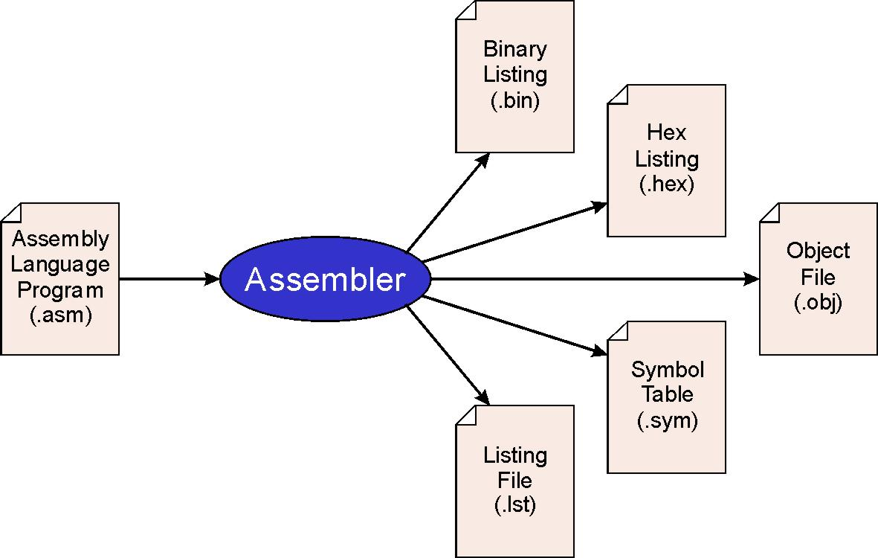
Assembler
MSP430 Assembler
An assembler outputs an object file
An assembler translates a program into machine code
An assembly program is a text file containing assembly instructions, directives, macros, and comments
An object file is input to a linker program
Notes:
17

Slide 18
Assembler Coding Format
MSP430 Assembler
Instructions / DIRECTIVES start in column 12.
No line should exceed 80 characters.
Operands start in column 21.
Comments start in column 45.
Labels start in column 1 and are 10 characters or fewer.
;*************************************************************************
; CS/ECEn 124 Lab 1 - blinky.asm: Software Toggle P1.0
;
; Description: Toggle P1.0 by xor'ing P1.0 inside of a software loop.
;*************************************************************************
DELAY .equ 0
.cdecls C,"msp430.h" ; MSP430
.text ; beginning of executable code
start: mov.w #0x0400,SP ; init stack pointer
mov.w #WDTPW|WDTHOLD,&WDTCTL ; stop WDT
bis.b #0x01,&P1DIR ; set P1.0 as output
mainloop: xor.b #0x01,&P1OUT ; toggle P1.0
mov.w #DELAY,r15 ; use R15 as delay counter
delayloop: sub.w #1,r15 ; delay over?
jnz delayloop ; n
jmp mainloop ; y, toggle led
.sect ".reset" ; MSP430 RESET Vector
.word start ; start address
.end
Begin writing your assembly code after the ".text" directive.
The ".cdecls" directive inserts a header file into your program.
Instructions are lower case and macros are UPPER CASE.
Use macros provided in the MSP430 header file.
The ".end" directive is the last line of your program.
Assembler directives begin with a period (.)
Label
Operation
Operands
Comments

Slide 19
Symbols / Labels
Assembly Code
Symbols
Symbols are name/value pairs and stored in a symbol table.
A symbol name is a string of up to 200 alphanumeric characters (A-Z, a-z, 0-9, $, and _), cannot contain embedded blanks, is case sensitive, and the first character cannot be a number.
A symbol value is a label, constant, or substitution value.
Symbols used as labels become symbolic addresses that are associated with locations in the program.
Labels
Labels are symbols.
Labels begins in column 1 and is optionally followed by a colon.
The value of a label is the current value of the Location Counter (address within program).
A label on a line by itself is a valid statement.
Labels used locally within a file must be unique.

Slide 20
Mnemonics / Operands
Assembly Code
Mnemonic Field
The mnemonic field cannot start in column 1; if it does, it is interpreted as a label.
The mnemonic field contains one of the following items:
MSP430 instruction mnemonic (ie. ADD, MOV, JMP)
Assembler directive (ie. .data, .list, .equ)
Macro directive (ie. .macro, .var, .mexit)
Macro invocation
Operand Field
The operand field follows the mnemonic field and optionally contains one or more operands.
An operand may consist of:
Symbols
Constants
Expressions (combination of constants and symbols)
Operands are separated with commas
Notes:
20

Slide 21
Constants / Expressions
Assembly Code
Constants are maintained internally as a 32-bit, signed (2’s complement) or unsigned numbers.
Constants are not sign extended.
The pound sign precedes a constant in an instruction
Decimal: decimal digits ranging from -2147483648 to 4294967295 (ie, 1000, -32768)
Hexadecimal: up to 8 hexadecimal digits followed by ‘H’ (or ‘h’) or preceded by ‘0x’ (ie, 78h, 0x78)
Binary: up to 32 binary digits followed by suffix B (or b) (ie. 0000b, 11110000B)
An expression is a constant, a symbol, or a series of constants and symbols separated by arithmetic operators that evaluates to a single 32-bit number.
-2147483648 to 2147483647 for signed values
0 to 4294967295 for unsigned values
Notes:
21

Slide 22
Expressions / Operators
Assembly Code
The precedence order of expression evaluation is
Evaluate parenthesized expressions
Evaluate operators according to precedence groups
When parentheses and precedence groups do not determine the order of expression evaluation, the expressions are evaluated from left to right
Group Operator Description
1 +, -, ~, ! Unary plus, minus, 1’s complement, logical NOT
2 *, /, % Multiplication, Division, Modulo
3 +, - Addition, Subtraction
4 <<, >> Shift left, Shift right
5 <, <=, >, >= Less than, Less than or equal to, Greater than, Greater than
or Equal to
6 =[=], != Equal to, Not equal to
7 & Bitwise AND
8 ^ Bitwise exclusive OR (XOR)
9 | Bitwise OR
Notes:
22

Slide 23
Assembler Directives
Assembly Code
Assembly directives are used to:
Create symbol table entries (.equ, .set, .cdecls).
Select assembler sections (.sect, .bss, .text).
Define values for memory locations (.byte, .word, .string).
Specify the end of program (.end).
;*******************************************************************************
; CS/ECEn 124 Example Code
;*******************************************************************************
.cdecls C,"msp430x22x4.h" ; include C header
COUNT .equ 2000
;------------------------------------------------------------------------------
.bss cnt,2 ; ISR counter
;------------------------------------------------------------------------------
.text ; Program reset
start: mov.w #0x0400,SP ; Initialize stack pointer
mov.w #WDT_MDLY_0_5,&WDTCTL ; Set Watchdog interval to ~0.5ms
bis.w #LPM0+GIE,SR ; Enter LPM0 w/ interrupt
jmp $ ; Loop forever; interrupts do all
.sect ".reset" ; MSP430 RESET Vector
.word start ; Power Up ISR
.end
Directives
Current Location Counter

Slide 24
Assembly Style Guidelines
Assembly Code
Provide a program header, with author’s name, date, etc., and purpose of program.
Start labels, opcode, operands, and comments in same column for each line. (Unless entire line is a comment.)
Use comments to explain what each register does.
Remember, the assembler is case sensitive.
Use meaningful symbolic names.
Mixed upper and lower case for readability.
ASCIItoBinary, InputRoutine, SaveR1
Provide comments between program sections.
Each line must fit on the page -- no wraparound or truncations.
Long statements split in aesthetically pleasing manner.

Slide 25
Quiz 6.2
What is an expression?
What is the difference between a symbol and a label?
Can the name “add” be used as a label?
What is the difference between a directive and a mnemonic?

Slide 26
Assembler Sections

Slide 27
Assembler Sections
Assembler Sections
A section is a block of code or data that occupies contiguous space in the memory map.
Each section has its own Location Counter.
The assembler assembles into the current section.
There are two types of sections:
Initialized sections containing data or code (modal)
.sect
.text
Uninitialized sections reserving space in the memory map for uninitialized data (temporary)
.bss
.usect
Object File |  | Target Memory
.bss var,2 |  | RAM
.usect "mySection"
.text
 |  | ROM (Flash)
.sect "reset"

Slide 28
Location Counter
Assembler Sections
The Location Counter holds the relative memory position of an instruction within the current section.
Each section has a location counter used to assign storage addresses to your program's statements.
As the instructions of a source module are being assembled, the location counter keeps track of the current location in storage.
A $ (dollar sign) can be used as an operand to an instruction to refer to the current value of the location counter.
The assembler assembles into the current section.
An initialized section directive instructs the assembler to stop assembling in the current section and begin assembling in the indicated section.
An uninitialized section directive does not end the current section, but simply escape from the current section temporarily. (Thus uninitialized directives .bss and .usect can appear anywhere in an initialized section without affecting its contents.)

Slide 29
Quiz 6.3
List the Location Counter values for the following:
 | .cdecls C,"msp430.h" ; include c header
 | .bss cnt,2 ; WDT second counter
 | .bss cat,4
 | .text ; program section
 | start: mov.w #0x0400,SP ; set stack pointer
 | mov.w #0x5a18,&WDTCTL ; set WD timer interval
 | mov.w #0x00fa,&cnt ; 1 sec WD counter
 | mov.b #0x01,&IE1 ; enable WDT interrupt
 | bis.b #0x01,&P1DIR ; P1.0 output
 | bis.w #0x0018,SR ; enable interrupts
 | .bss dog,2
 | wdt_isr: xor.b #0x01,&P1OUT ; toggle P1.0
 | reti ; return from interrupt
 | .sect ".int10" ; WDT vector section
 | .word wdt_isr ; Watchdog ISR
 | .sect ".reset" ; PUC vector section
 | .word start ; RESET ISR
 | .end

Slide 30
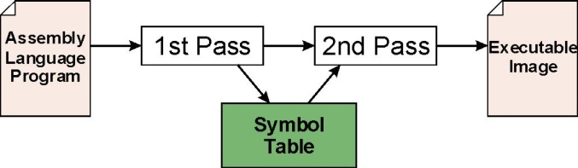
Assembly Process
Assembly Process
The assembler translates 1-to-1 assembly language instructions (.asm) into the machine language of the ISA (.obj)
1st Pass: store all labels/constants and their corresponding addresses/values in the symbol table
Zero all Location Counters ($)
For each non-empty line in the .text section:
if line contains a label, add label and current LC to the symbol table
if line contains an instruction, increment the LC accordingly
Stop when .end directive is found.
2nd Pass: convert instructions to machine language, using information from symbol table
Find the .text assembly directive and zero all Location Counters ($)
For each executable assembly language statement:
generate the corresponding machine language instruction
resolve labels referenced in instructions using the symbol table
increment LC for each instruction as in pass 1
output resulting machine code and program listing to output files
Stop when .end directive is found.

Slide 31
Common Assembler Directives
Assembler Directives
Reserves uninitialized
bytes in RAM section
(Does NOT change
current section)
Mnemonic and Syntax | Description
.bss symbol, size in bytes[, alignment] | Reserves size bytes in the .bss (uninitialized data) section
.sect "section name" | Assembles into a named (initialized) section
.text | Assembles into the .text (executable code) section
.byte value₁[, ..., value_{n}] | Initializes one or more successive bytes in the current section
.string "string₁"[, ..., "string_{n}"] | Initializes one or more text strings
.word value₁[, ... , value_{n}] | Initializes one or more 16-bit integers
.align [size in bytes] | Aligns the LC on a boundary specified by size in bytes; must be a power of 2; defaults to word (2 byte)
.def symbol₁[, ... , symbol_{n}] | Identifies one or more symbols that are defined in current module and that can be used in other modules
.include ["]filename["] | Includes source statements from another file
.ref symbol₁[, ... , symbol_{n}] | Identifies one or more symbols used in the current module that are defined in another module
symbol .equ value | Equates value with symbol
symbol .set value | Equates value with symbol
.cdecls [options,] "filename" | Share C headers between C and assembly code
.end | Ends program
Changes to new section
(New Location Counter)
Fills (initializes) bytes
in CURRENT section
(Does NOT change section)
Creates Name/Value
symbol table entry
(Does NOT effect any
section Location Counter)

Slide 32
Linker
Linker
The Linker program "links" two files together according to their declared sections:

Slide 33
Library Routines
Libraries
Library
A set of routines for a specific domain application.
Example: math, graphics, GUI, etc.
Use the .ref directive to reference symbols defined outside a program.
Library routine invocation
Labels for the routines are defined as .def
Each library routine contains its own symbol table.
A linker resolves the external addresses before creating the executable image.
Reports and unresolved symbols.

Slide 34
Linking Multiple Files
Libraries
Linker
Module A
Object
Source Module A
Assembler
.ref myFunc
.ref sqrt
.text
…
call #myFunc
call #sqrt
…
.end
Executable Image
Symbol Table
Module A
Object
Module B
Object
Module B
Object
Assembler
Symbol Table
Source Module B
Math
Library
.def myFunc
.text
myFunc:
…
ret
.end
Math
Library
Symbol Table

Slide 35
Quiz 6.4
Create assembler and linker symbol table values for the following program: (Note: the linker loads the .text section at memory address 0xc000.)
DELAY .equ 0
.text
reset: mov.w #0x0400,SP
mov.w #0x5a80,&0x0120
bis.b #0x01,&0x0022
mloop: xor.b #0x01,&0x0021
mov.w #DELAY,r15
dloop: dec.w r15
jnz dloop
dlp2: dec.w r15
jnz dlp2
jmp mloop
.sect ".reset"
.word reset
.end
Symbol Name | Assembler Symbol Value | Resolved Linker Value

Slide 36
How to Code Assembler

Slide 37
How To Code Assembler…
Coding Assembler
Understand the problem (obviously)
Until you are comfortable in assembly, (and even afterwards), write out your solution in something familiar
English
Flowchart
Pseudo-code
Java, C, Ruby – the pseudo-code doesn’t really matter!
Then, translate to assembler

Slide 38
Three Basic Constructs
Coding Assembler

Slide 39
if-then-else
Coding Assembler
if-then-else
cmp.w #1,buzzerON ;
jne myElse ;
xor.b #0x20,&P4OUT ;
bis.b #0x02,&P1OUT ;
jmp myNext ;
myElse: ;
bic.b #0x02,&P1OUT ;
;
myNext: ;
if (buzzerON == 1)
{
pulse_buzzer();
turn_on_LED();
}
else
{
turn_off_LED();
}

Slide 40
switch / case
Coding Assembler
switch / case
cmp.w #DOT,myByte ;
jne sw_01 ;
call #do_dot ;
jmp sw_end ;
sw_01:
cmp.w #DASH,myByte ;
jne default ;
call #do_dash ;
jmp sw_end ;
;
default: ;
sw_end: ;
switch (myByte)
{
case DOT:
do_dot();
break;
case DASH:
do_dash();
break;
default:
}

Slide 41
for-loop
Coding Assembler
for-loop
.bss i,2 ;
mov.w #0,i ;
for_ck: cmp.w #10,i ;
jge for_done ;
call #do_dot ;
call #delay ;
call #do_dash ;
call #delay ;
add.w #1,i ;
jmp for_ck ;
for_done: ;
int i;
for(i=0; i<10; i++)
{
do_dot();
delay();
do_dash();
delay();
}

Slide 42
while
Coding Assembler
while loop…
TRUE .equ 1
.bss blink,2 ;
mov.w #TRUE,blink ;
while_loop: ;
cmp.w #0,blink ;
jeq while_done ;
call #LED_ON ;
call #delay ;
call #LED_OFF ;
call #delay ;
jmp while_loop ;
while_done: ;
#define TRUE 1
int blink = TRUE;
while (blink)
{
LED_ON();
delay();
LED_OFF();
delay();
}

Slide 43
Quiz 6.5
Code the following C program in assembler:
int i;
void func1(void) { ++i; return; }
void func2(void) { i += 2; return; }
void main(void)
{
for (i = 1; i < 10; i++)
{
if (i < 5)
{
func1();
}
else
{
func2();
}
}
}

Slide 44
Systematic Decomposition
Systematic Decomposition
IDEA
Step by Step Procedure
Finiteness
Must terminate.
Definiteness
Each step is precisely stated.
Effective Computability
Each step can be carried out.

Slide 45
Stepwise Refinement
Systematic Decomposition
Also known as systematic decomposition.
Start with problem statement:
“Write an assembler program to play the game of Simon using the LEDs and push button switches.”
Decompose task into a few simpler subtasks.
Decompose each subtask into smaller subtasks, and these into even smaller subtasks, etc.... until you get to the machine instruction level.
Incrementally develop program and test, test, test…

Slide 46
Problem Statement
Systematic Decomposition
Because problem statements are written in English, they are sometimes ambiguous and/or incomplete.
How is the game played? How many LEDs start the game? Which switches and which LEDs? How long is an LED on or off? What happens when an error is made? What happens when a sequence is successfully reproduced? How is a new sequence started? …
How do you resolve these issues?
Ask the person who wants the problem solved, or
Make a decision and document it.

Slide 47
Simon Example
Systematic Decomposition
Incremental Development
Pseudo-code
Algorithm
start:
call #init_board
newGame:
call #new_game
call #saveRandSeed
mov.b #0xff,&success
mov.w #TRYS-1,&trys
tryLoop:
tst.b &success
jeq newGame
inc.w &trys
test:
mov.w #0,r15
testLoop:
cmp.w r15,&trys
jge player
call #getRand
and.w #0x0003,r12
call #doLEDsTone
inc.w r15
jmp testLoop:
player:
call #restoreRandSeed
...
Problem
while (1)
{ new_game:
{ saveRandSeed;
success = TRUE;
trys = TRYS-1;
}
while(success)
{ doSequence:
{ restoreRandSeed;
trys++;
for (i=0; i<trys; i++)
{ getRand;
doLEDsTone;
}
}
doPlayer:
{ restoreRandSeed;
for (i=0; i<trys; i++)
{ getSwitch;
doLEDsTone;
if (getRand ≠ switch)
{ success = FALSE;
break;
}
}
}
doResults:
{ if (success) outSuccess;
else outRaspberry;
}
}
}
Init Simon board.
Setup new game.
“Play the game of Simon using the LEDs and push button switches.”
Output random sequence of tones and LEDs.
Reset sequence.
Get and compare player’s response.
Output results and restart game w/new sequence.

Slide 48


Slide 49

Energy Consumption

Slide 50
U.S. Energy Consumption
Energy Consumption
The United States is the 2nd largest energy consumer in terms of total use in 2010¹ in the world.
Not getting better – everyone must do their part.
How could I lower home energy consumption?
Turn off lights
Turn down thermostat
Unplug appliances not in use
Use slower motor speeds
Heat/cool at a slower rate
Improve insulation
Purchase energy efficient appliances
Eliminate unnecessary living space
How could I make computers more energy efficient?
1. Barr, Robert. "China surpasses US as top energy consumer". Associated Press. Retrieved 16 June 2012.
Notes:
1. Barr, Robert. "China surpasses US as top energy consumer". Associated Press. http://www.msnbc.msn.com/id/43327793/ns/business-oil_and_energy/t/china-surpasses-us-top-energy-consumer/#.T9y6aBSYNok. Retrieved 16 June 2012.

Slide 51
Computer Energy Consumption
Energy Consumption
Computers occupy a small but growing percentage of annual U.S. electricity consumption.
Estimates vary for 3% to 13% of entire U.S. supply.
Hidden costs – every 100 watts consumed by computers requires 50 watts of cooling.
Computers are ubiquitous – found in every energy sector.
Battery capacity doubles every 10 years while processing power doubles every 2 years.
Server farms, supercomputers, web hosting, scientific simulations, 3D rendering, search engines,…
Google uses enough energy to continuously power 200,000 homes (260 million watts – ¼ output of a nuclear power plant).
One Google search is equal to turning on a 60W light bulb for 17 seconds.
http://techland.time.com/2011/09/09/6-things-youd-never-guess-about-googles-energy-use/
Notes:
http://techland.time.com/2011/09/09/6-things-youd-never-guess-about-googles-energy-use/
Read more: http://techland.time.com/2011/09/09/6-things-youd-never-guess-about-googles-energy-use/#ixzz2MDRvGfYe

Slide 52

Clocks

Slide 53
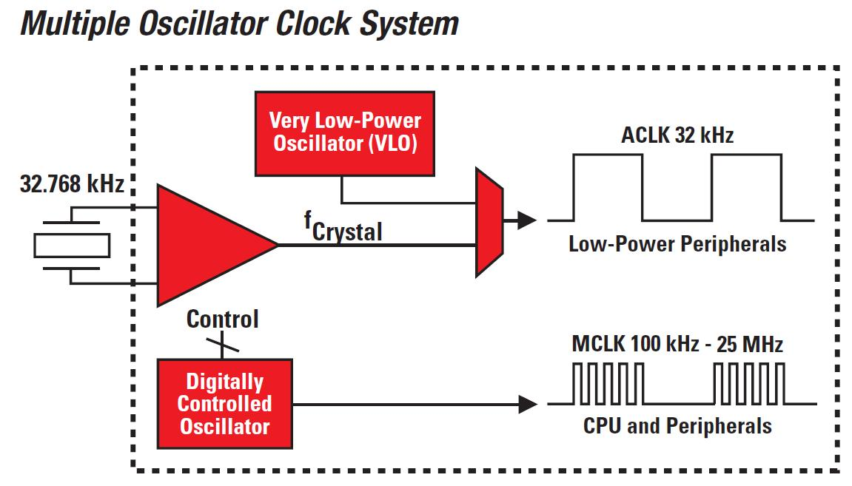
Processor Clock Speeds
Processor Clocks
Often, the most important factor for reducing power consumption is slowing the clock down.
Faster clock = Higher performance, more power required
Slower clock = Lower performance, less power required
; Set ACLK to ≈12kHz
mov.w #LFXT1S_2,&BCSCTL3
; Set DCO to 8 MHz:
mov.b #CALBC1_8MHZ,&BCSCTL1
mov.b #CALDCO_8MHZ,&DCOCTL
10% loss of power
60% loss of power

Slide 54

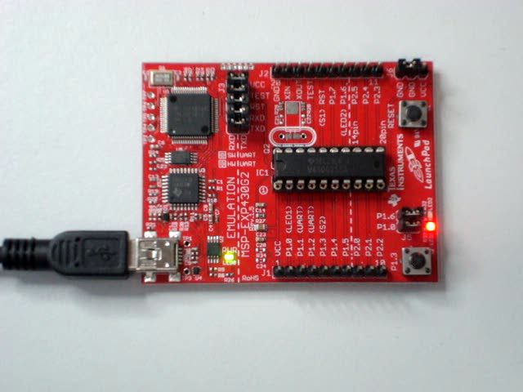
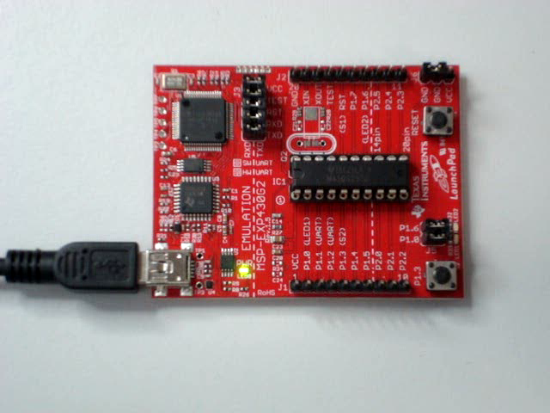
Example 6.1 – Clock Speed
Interrupts
.cdecls C,"msp430.h"
SMCLK .equ 1200000 ; 1.2 Mhz clock
WDT_CPS .equ SMCLK/8000 ; WDT clocks / second count
MHz8 .set 1 ; 8 MHz flag
; Code Section ------------------------------------------------------------
.text
start: mov.w #0x0400,SP ; init stack pointer
mov.w #WDT_MDLY_8,&WDTCTL ; stop WDT
.if MHz8 ; set DCO to 8 MHz
mov.b #CALBC1_8MHZ,&BCSCTL1 ; set range
mov.b #CALDCO_8MHZ,&DCOCTL ; set DCO step + modulation
.endif
bis.b #0x01,&P1DIR ; set P1.0 as output
mainloop: xor.b #0x01,&P1OUT ; toggle P1.0
mov.w #8,r14 ; use R14 as outer loop counter
delaylp1: mov.w #0,r15 ; use R15 as delay counter
delaylp2: sub.w #1,r15 ; delay over?
jne delaylp2 ; n
sub.w #1,r14 ; y, outer loop done?
jne delaylp1 ; n
jmp mainloop ; y, toggle led
; Interrupt Vectors -------------------------------------------------------
.sect ".reset" ; MSP430 RESET Vector
.word start ; start address
.end
Conditionally assemble setting new DCO constants (for 8 MHz)
Nested delay loop to blink LED

Slide 56


Low-Power Mode

Slide 57
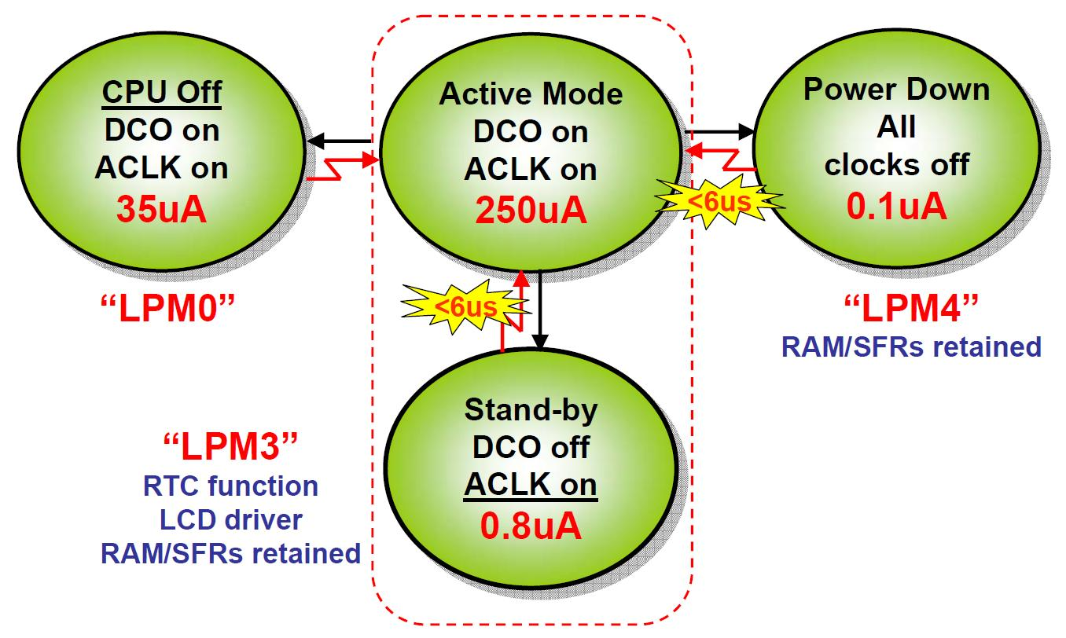
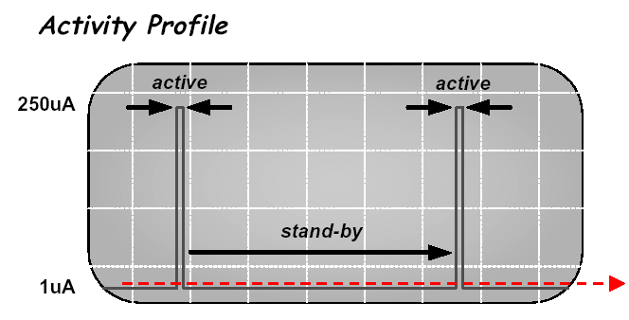
MSP430 Clock Modes
Low Power Modes
Another method to reduce power consumption is to turn off some (or all) of the system clocks.
A device is said to be sleeping when in low-power mode; waking refers to returning to active mode.
“Only Mostly Dead”
(7 Years vs 1 Day)
Average
300x Savings
(1 Year vs 1 Day)

Slide 58
Low Power Modes
MSP430 Clock Settings (r2)
Reserved | V | SCG1 | SCG0 | OSC OFF | CPU OFF | GIE | N | Z | C
Active Mode LPM0 LPM3 LPM4 |  | 0 0 1 1 | 0 0 1 1 | 0 0 0 1 | 0 1 1 1 | ~ 250 µA ~ 35 µA ~ 0.8 µA ~ 0.1 µA
SMCLK and ACLK Active
Only ACLK Active
No Clocks!
Sleep Modes
; enable interrupts / enter low-power mode 0
bis.w #LPM0|GIE,SR ; LPM0 w/interrupts
Can be combined

Slide 59
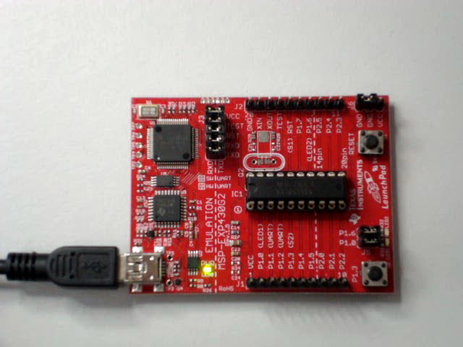
Example 6.2 – Low Power
Low-Power Mode
.cdecls C,"msp430.h"
SMCLK .equ 1200000 ; 1.2 Mhz clock
WDT_CPS .equ SMCLK/8000 ; WDT clocks / second count
STACK .equ 0x0400 ; top of stack
; Data Section ------------------------------------------------------------
.bss WDTSecCnt,2 ; WDT second counter
; Code Section ------------------------------------------------------------
.text
start: mov.w #STACK,SP ; initialize stack pointer
mov.w #WDT_MDLY_8,&WDTCTL ; set WD timer interval
mov.w #WDT_CPS,&WDTSecCnt ; initialize 1 sec WD counter
bis.b #WDTIE,&IE1 ; enable WDT interrupt
bis.b #0x01,&P1DIR ; P1.0 output
loop: bis.w #LPM0|GIE,SR ; sleep/enable interrupts
xor.b #0x01,&P1OUT ; toggle P1.0
jmp loop ; loop indefinitely
; Watchdog ISR ------------------------------------------------------------
WDT_ISR: sub.w #1,&WDTSecCnt ; decrement counter, 0?
jne WDT_02 ; n
mov.w #WDT_CPS,&WDTSecCnt ; y, re-initialize counter
bic.b #LPM0,0(SP) ; wakeup processor
WDT_02: reti ; return from interrupt
; Interrupt Vectors -------------------------------------------------------
.sect ".int10" ; Watchdog Vector
.word WDT_ISR ; Watchdog ISR
.sect ".reset" ; PUC Vector
.word start ; RESET ISR
.end
Configure Watchdog as a timer
Enable device to interrupt
Enable interrupts / Goto Sleep
(Low-power Mode 0)
4. Blink LED when awakened
Activity Profile
5. Reset counter every second
6. Set Active Mode in saved SR
7. Wakeup processor on RETI
300µA
active
sleep
1µA
average

Slide 60
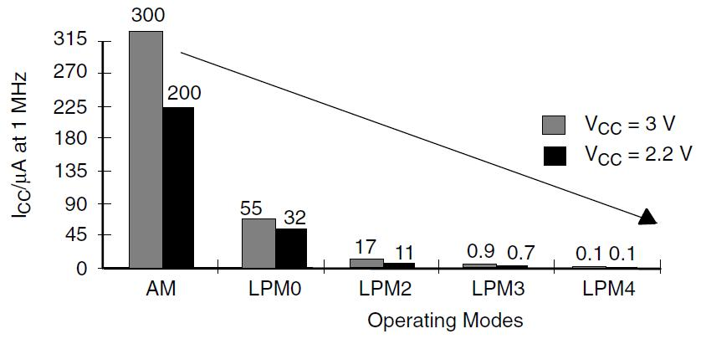
Lower Power Savings
Low Power Modes
Finally, powering your system with lower voltages means lower power consumption as well.
P=CV²F
where
P=power consumption
C=load capacitance
V=operating voltage
F=frequency.

Slide 61
Principles of Low-Power Apps
Low Power Modes
Maximize the time in low-power modes.
Sleep as long as possible and use interrupts to wakeup.
Use the slowest clock while still meeting processing needs.
Switch on peripherals only when needed (ie, switch off peripherals when not needed).
Use low-power integrated computer peripherals.
Timers: Timer_A and Timer_B for PWM
A/D convertors, flash, LCD’s
Use faster software algorithms / programming techniques
Calculated branches instead of flag polling.
Fast table look-ups instead of iterative calculations.
Use in-line code instead of frequent subroutine / function calls.
More single-cycle CPU register usage.

Slide 62
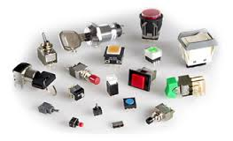
Switches

Slide 63
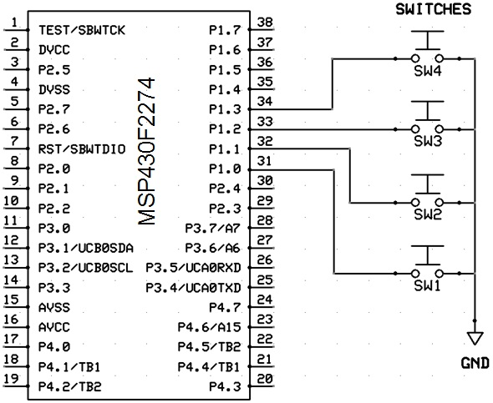
Switches
Switch Debounce
Switches
Port 1, bits 0-3
Use internal pull-ups
Use interrupts
H to L transition
Require debouncing
bic.b #0x0f,&P1DIR ; set P1.0-3 as inputs
bis.b #0x0f,&P1OUT ; use pull-ups
bis.b #0x0f,&P1REN ; enable pull-ups
bis.b #0x0f,&P1IES ; high to low transition
bis.b #0x0f,&P1IE ; enable interrupts

Slide 64
Switch Debounce
Switch Debounce
Switch Pressed
Switch Released
3.3
Logic "High"
2.4
Undefined
0.5
0.0
Logic "Low"
Switch "debounced" after signal remains low for specified time

Slide 65
Example 6.3 Switch Debounce
Switch Debounce
.cdecls C,"msp430.h"
.bss WDT_dcnt,2 ; WDT second counter
.bss switches,2 ; switches
.text
RESET: mov.w #0x0600,SP ; init stack pointer
mov.w #WDT_MDLY_8,&WDTCTL ; WDT SMCLK, 8 ms (@1 Mhz)
bis.b #WDTIE,&IE1 ; enable WDT interrupt
clr.w WDT_dcnt ; clear debounce counter
bis.b #0x0f,&P4DIR ; set P4.0-3 as outputs
bic.b #0x0f,&P1DIR ; set P1.0-3 as inputs
bis.b #0x0f,&P1OUT ; pull-up
bis.b #0x0f,&P1REN ; enable pull-ups
bis.b #0x0f,&P1IES ; high to low transition
bis.b #0x0f,&P1IE ; enable interrupts
mainloop: bis.w #LPM0|GIE,SR ; enable interrupts/goto sleep
xor.b switches,&P4OUT ; output (toggle) P4.0-3
jmp mainloop
; Port 1 ISR --------------------------------------------------------------
DEBOUNCE .equ 5 ; debounce count (~40 ms)
P1_ISR: bic.b #0x0f,&P1IFG ; put its hand down
mov.w #DEBOUNCE,WDT_dcnt ; reset debounce counter
reti
; Watchdog ISR ------------------------------------------------------------
WDT_ISR: cmp.w #0,WDT_dcnt ; debouncing?
jeq WDT_02 ; n
sub.w #1,WDT_dcnt ; y, decrement counter, 0?
jne WDT_02 ; n
mov.b &P1IN,switches ; y, read switches
xor.b #0x0f,switches ; positive assertion
and.b #0x0f,switches ; mask low 4 bits (switches)
bic.b #LPM0,0(SP) ; wake up
WDT_02: reti ; return from interrupt
.sect ".int02"
.word P1_ISR ; Port 1 ISR
.sect ".int10
.word WDT_ISR ; Watchdog ISR
.sect ".reset"
.word RESET ; RESET ISR
.end
Configure Switches:
High to Low
Pull-ups
Enable interrupts
Port 1 ISR
Reset debounce counter
Watchdog ISR
Decrement WDT_cnt (if non-zero), read switch and wakeup main routine.
Port 1 interrupt vector

Slide 66
LED’s

Slide 67

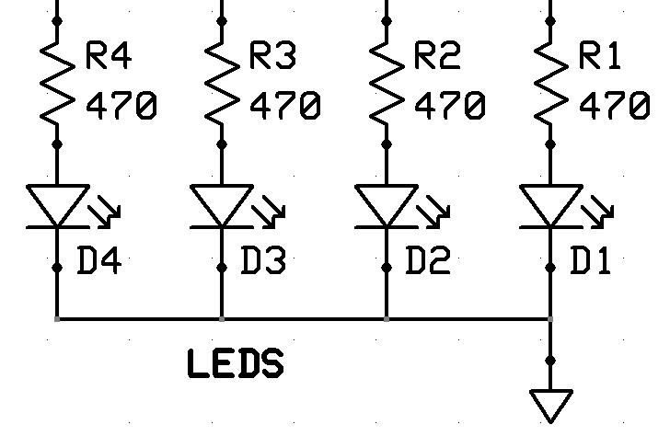
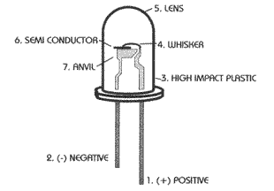
LEDs
Device: LED
A light-emitting diode (LED) is a semiconductor light source
When a diode is forward biased (switched on), electrons are able to recombine with holes within the device, releasing energy in the form of photons

Slide 68
LEDs
Device: LED
LaunchPad Development Tool (MSP430G2553)
P1.0 Red LED
P1.6 Green LED
RBX430 Development board (MSP430F2274)
P3.4 Green LED (LED5)
P4.0-3 Green, Orange, Yellow, Red LEDs (LED1-4)
P4.6 Red LED (LED6)
Example
bis.b #0x0f,&P4DIR ; P4.0-3 output
bic.b #0x0f,&P4OUT ; turn off all LEDs
bis.b #0x03,&P4OUT ; turn on #3 & #4
xor.b #0x0f,&P4OUT ; toggle 1-2, 3-4 LEDs

Slide 69
Quiz 6.6
What does the following assembly code do?
.cdecls c,"msp430.h"
.text
start: mov.w #0x0400,SP
mov.w #0x5a80,&WDTCTL
bis.b #0x0f,&P4DIR
bic.b #0x0f,&P4OUT
mov.w #0,r15
mloop: mov.b #0x08,r4
dloop: sub.w #1,r15
jne dloop
xor.b r4,&P4OUT
rrc.b r4
jnc dloop
jmp mloop
.sect ".reset"
.word start
.end

Slide 70


